Slide 1



The Guardian Project

Slide 2



Guardian Project is a research and development effort powered by technology-focused activists, concerned citizen users, and open-source security software hackers. We build tools based on real-world experience and feedback. Our process is transparent, inclusive and responsible.

Slide 3
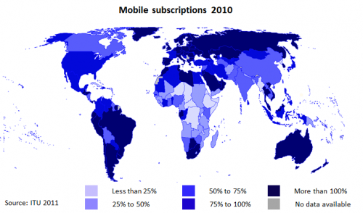

The number of smart-phones owned almost doubled in one year from 19% in 2010 to 35% in 2011 and is expected to rise over the next 12 months. There are now 4.5 billion mobiles in the developing world alone.
(Source) Worldwide Independent Network for Market Research (WIN)
& GALLUP International, United Nations Development Program, USAID

Slide 4



Open Source
Participatory
Accountable
Efficient
Truly Secure

Slide 5
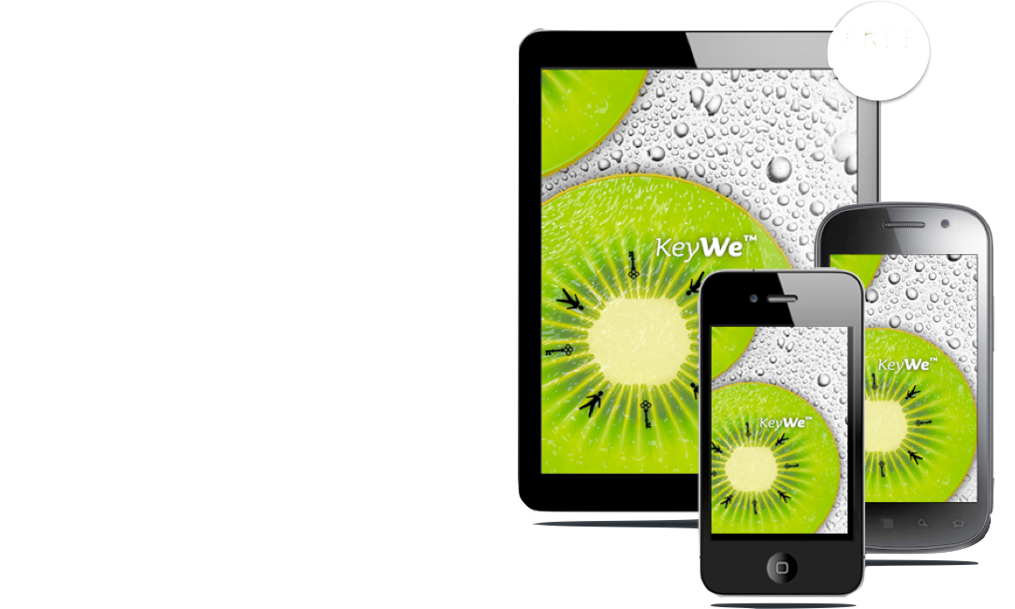


Platform
Agnostic
Mobile is currently the least secure of all systems. Our goal is to change this. From Android, where we can verify the core to Apple iOS where we can build apps, we are leading the charge.

Slide 6

ANDROIDS
BIRTHS
The number of smart-phones owned almost doubled in one year from 19% in 2010 to 35% in 2011 and is expected to rise over the next 12 months. There are now 4.5 billion mobiles in the developing world alone.
1,300,000
300,000
2012
(Source) Worldwide Independent Network for Market Research (WIN)
& GALLUP International, United Nations Development Program, USAID
http://www.telegraph.co.uk/technology/ces/9013487/CES-2012-Android-activations-outpacing-baby-births.html

Slide 7


















SMALL WORLD NEWS
PARTNERSHIPS
We believe in protocols, not products / in partnerships, not proprietary fiefdoms / in building a community of collaborators, not a cacophony of criticism and unnecessary competition / in practical solutions to perilous problems.

Slide 8


activists & citizen journalists
Tech savvy citizen journalists and activists in the street use Guardian apps to share updates, photos and videos without interception or monitoring by the authorities.

Slide 9
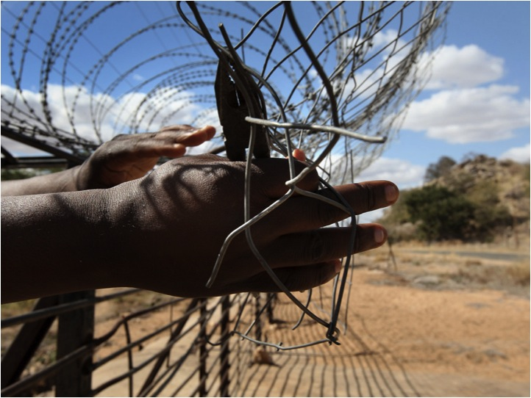

human rights defenders
An undercover human rights researcher traveling through a remote region without mobile data service is able to use Guardian to document local conditions using secured video, audio and photo capture. Data is stored encrypted on the device, and if necessary, it can be safely and quickly erased.

Slide 10


frontline reporters
Reporters in the field can use Guardian apps to stay in touch with their safety networks, while safeguarding information on contacts, story notes and captured digital media, enabling a new, secure "reporter's notepad". In addition, high-resolution cameras of new Android hardware meet the quality standards for broadcast, print and online production.

Slide 11
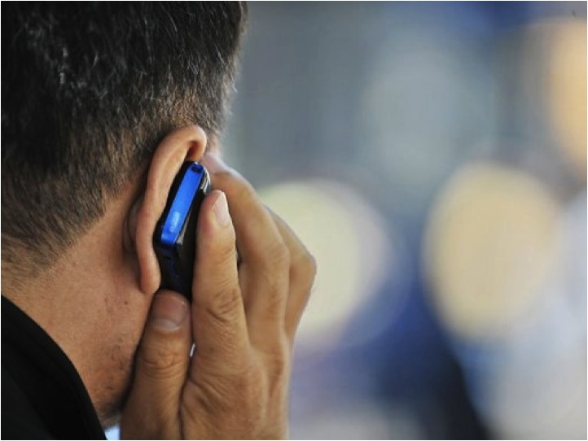

business
Business people travel all over the world, using foreign networks, bandwidth and systems. At any point, confidential information can be compromised. While some organizations implement solutions, these are often expensive, difficult to use, and not comprehensive

Slide 12
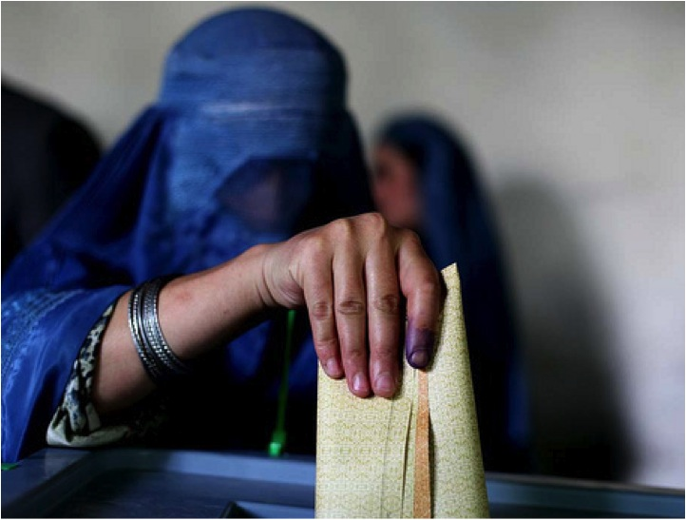

Election monitors
Election monitoring teams distribute low cost Android phones to community organizations to report on issues. Guardian apps assure reports are sent without being tampered with and provides the ability to coordinate via secure instant messaging on low bandwidth networks.

Slide 13
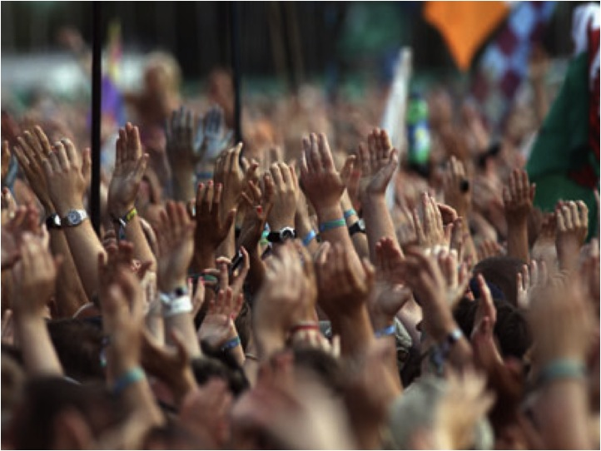

Everyday Mobile Internet Freedom
Mobile users in censorship states can use Guardian apps to get around the content filters, firewalls and monitors. Everyday citizens use the apps to watch online video, read blogs, communicate safely with friends, and otherwise access whatever content they would like, encouraging open society and culture.

Slide 14
THREATS
Notes:
Data Stealer: Steals and sends specific information from the user’s phone to criminals
Premium Services: Subscribes infected phones to premium services without the user’s authorization or knowledge
Click Fraud: Abuses mobile devices via pay-per-click online ads
Malicious Downloader: Downloads other malware and malicious apps onto infected devices
Spying Tools: Tracks GPS data and sends it to a third party
Rooter: Takes complete control over phones and their functions

Slide 15
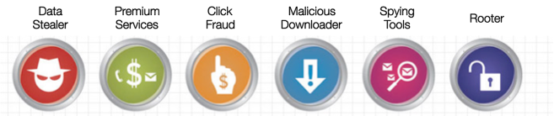
MALWARE
Ways to hijack info from apps
Notes:
Data Stealer: Steals and sends specific information from the user’s phone to criminals
Premium Services: Subscribes infected phones to premium services without the user’s authorization or knowledge
Click Fraud: Abuses mobile devices via pay-per-click online ads
Malicious Downloader: Downloads other malware and malicious apps onto infected devices
Spying Tools: Tracks GPS data and sends it to a third party
Rooter: Takes complete control over phones and their functions

Slide 16
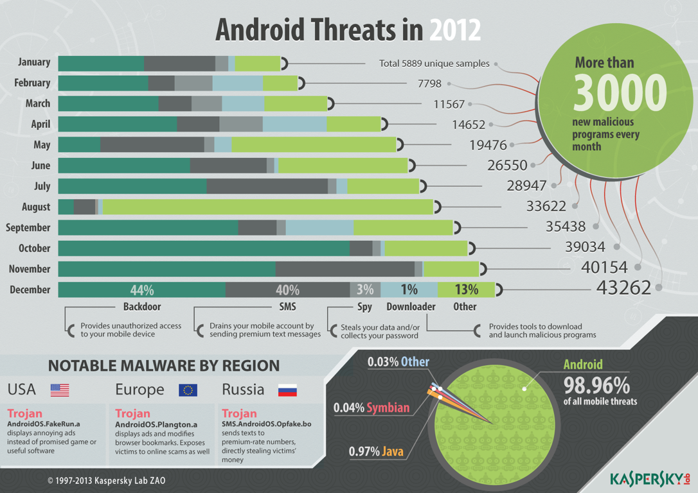

Slide 17
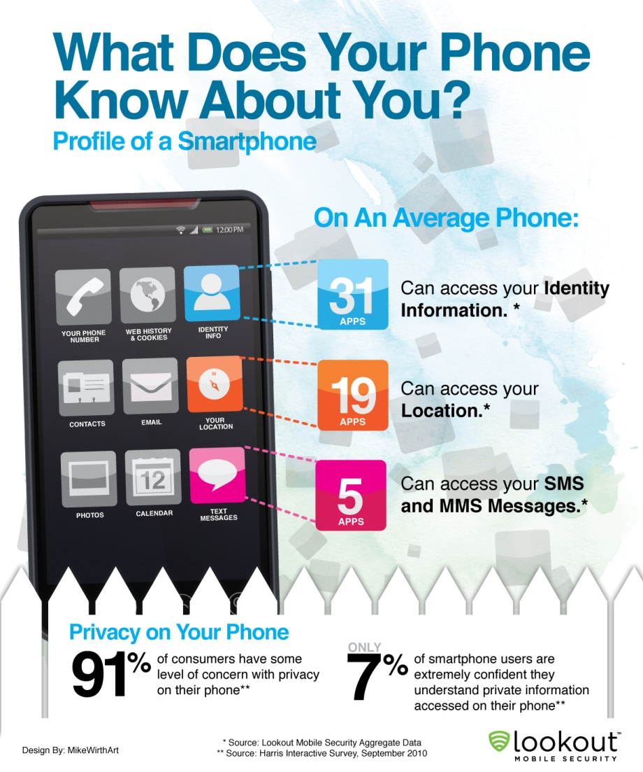
Notes:
september 2010

Slide 18
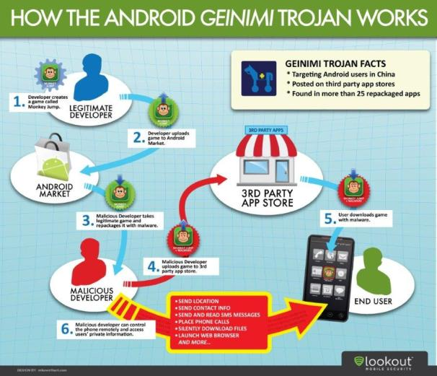
Notes:
phishing

Slide 19
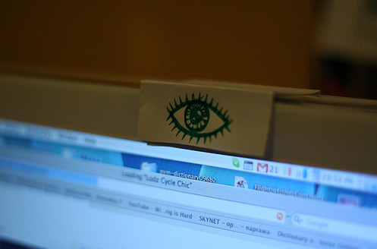
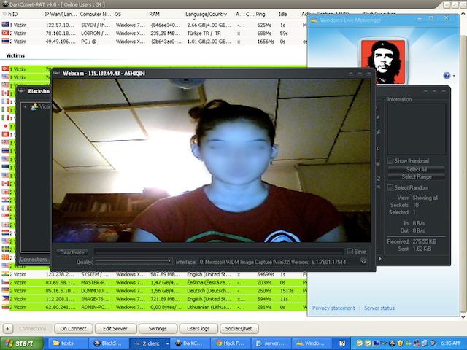

REMOTE EAVESDROPPING
Notes:
https://www.schneier.com/blog/archives/2006/12/remotely_eavesd_1.html
The surveillance technique came to light in an opinion published this week by U.S. District Judge Lewis Kaplan. He ruled that the "roving bug" was legal because federal wiretapping law is broad enough to permit eavesdropping even of conversations that take place near a suspect's cell phone.
Kaplan's opinion said that the eavesdropping technique "functioned whether the phone was powered on or off." Some handsets can't be fully powered down without removing the battery; for instance, some Nokia models will wake up when turned off if an alarm is set.

Slide 20
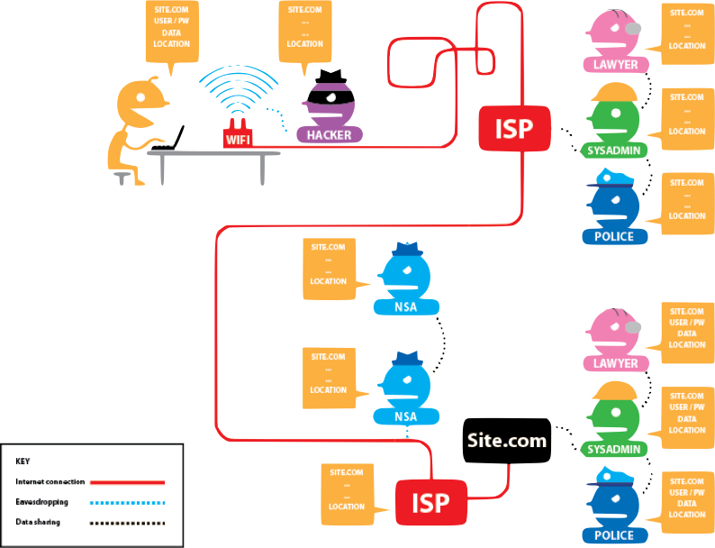
Internet Browsing

Slide 21


Content
Metadata
Vs.

Slide 22
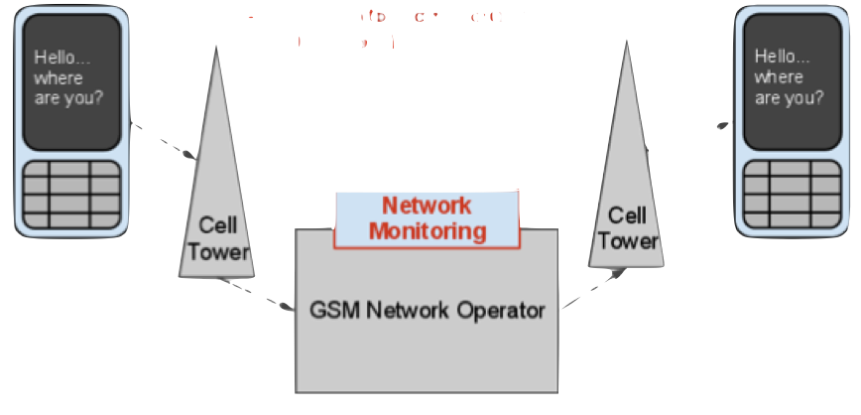
MOBILE NETWORKS
Data Logged :
- Device Equipment ID (IMEI)
- Subscriber ID (IMSI) / Phone #
- Message (to, from, content)
- Cell Tower / Location
2600.org

Slide 23
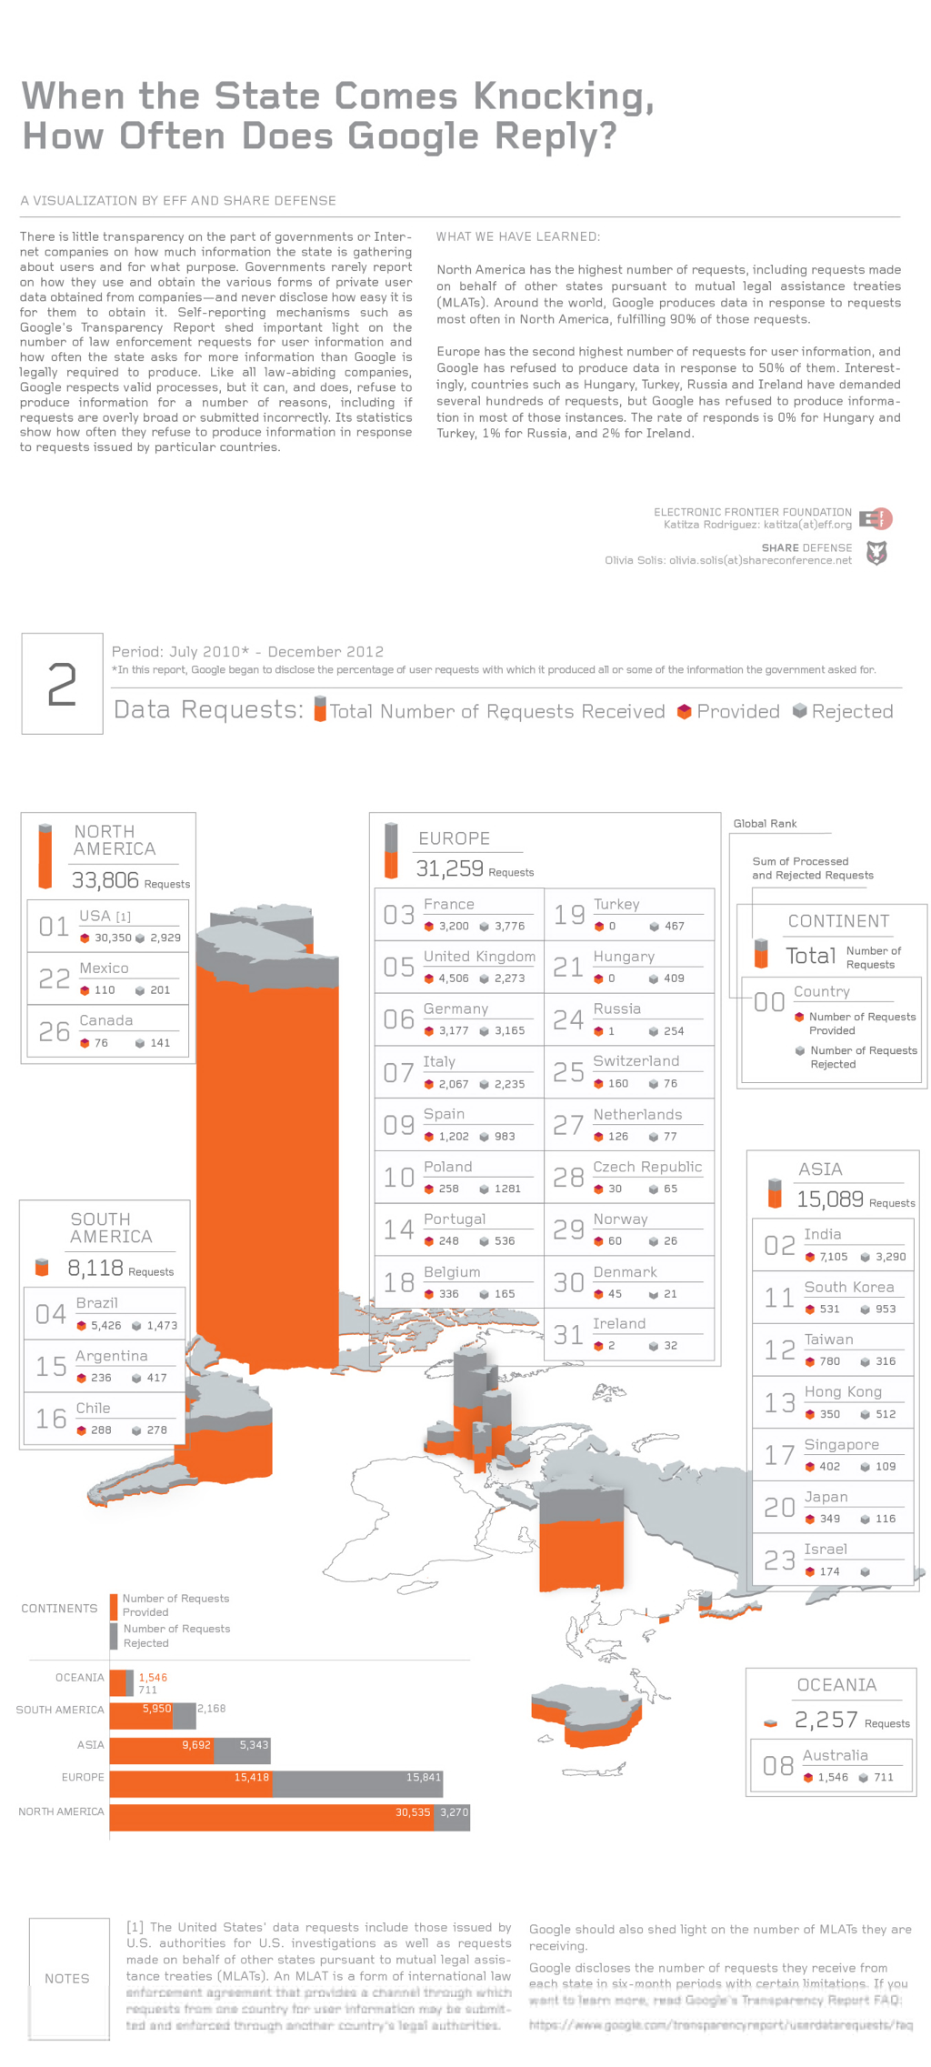
DATA REQUESTS
Notes:
data requests - number rejected / provided

Slide 24
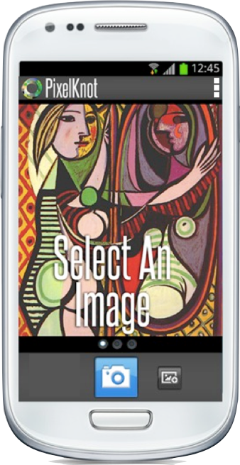
MOBILE PHONES
Have 2 computers:
Processor
&
Baseband
One can be secured but the other serves as a ‘black box’, which is much harder to decipher and understand the security of.

Slide 25

SECURITY
Apps available publicly all over the world for download, installation and easy use.

Slide 26
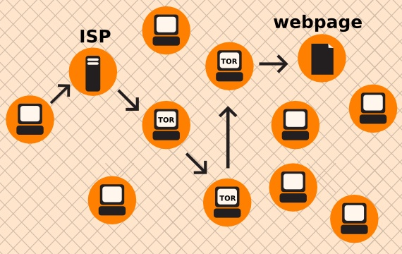
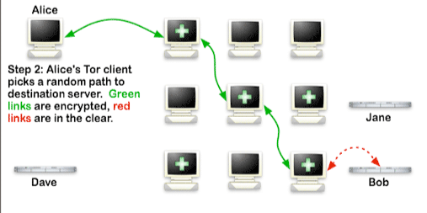
Anonymous Browsing

Slide 27
End to End encryption
Alice
Bob
Eve
Public Key Cryptography :
Diffie-Hellman Key Exchange

Slide 28


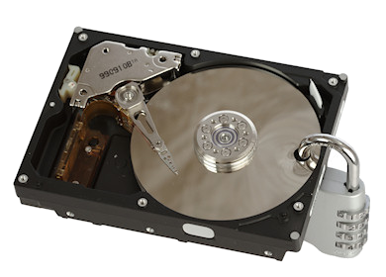

Data at Rest

Slide 29
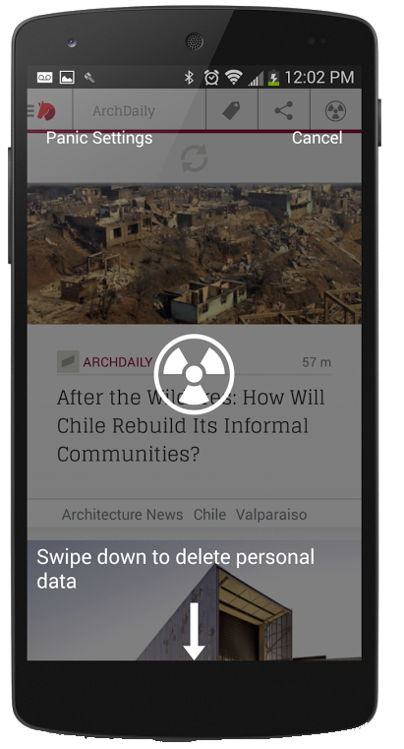
Panic Button

Slide 30
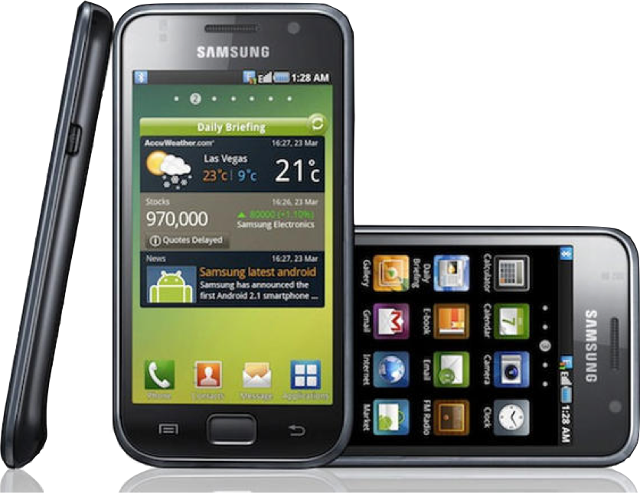
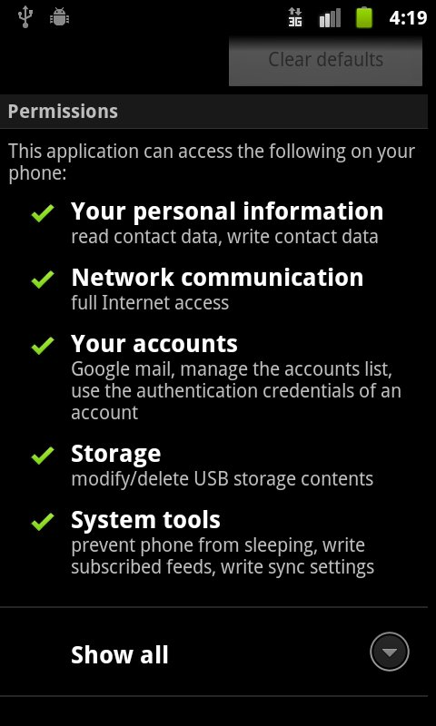
Understandable Permissions

Slide 31

User tools
Apps available publicly all over the world for download, installation and easy use.

Slide 32
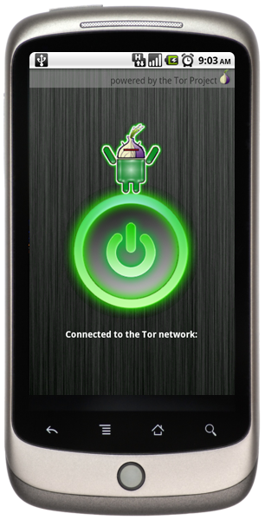
Orbot
Tor on Android: providing free software and an open network that helps defend against network traffic analysis - a form of surveillance that threatens personal freedom and privacy
With root access, proxy all application traffic through Tor
Firefox on Android integration through ProxyMob Add-on
Works on 2.5G, 3G and Wifi nets
Supports running servers on hidden services for advanced applications
Enables devices to be a Tor hotspot

Slide 33
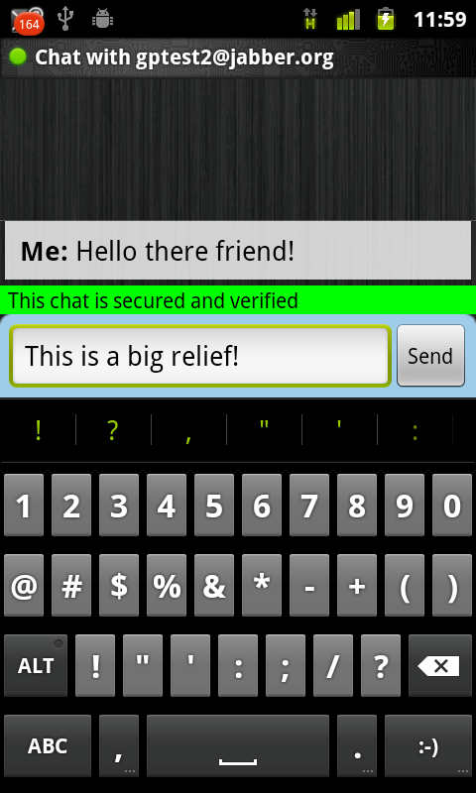
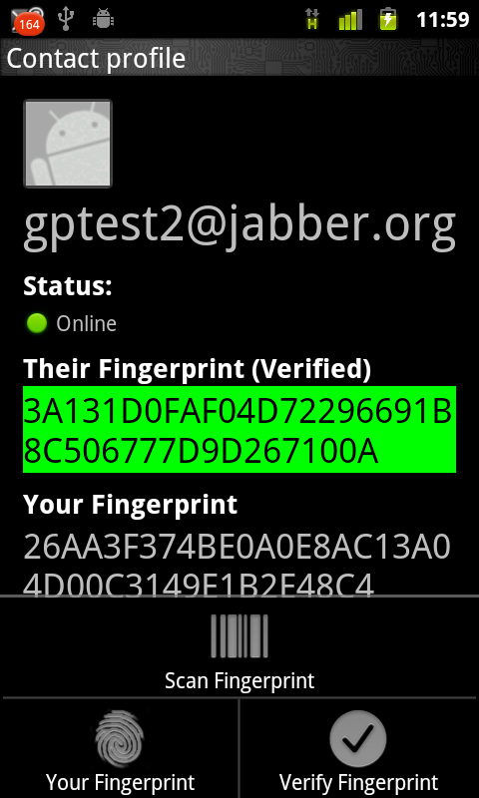
ChatSecure
A secure, no-logging instant messaging app for Android, supporting open standard chat and encryption protocols
Uses industry standard chat encryption scheme (OTR), compatible with Pidgin, Adium, Jitsi and other desktop IM apps
XMPP protocols enables use with GTalk, Facebook, as well as any self-hosted, secured server
Can work with Orbot (over Tor) to circumvent firewalls and monitors

Slide 34
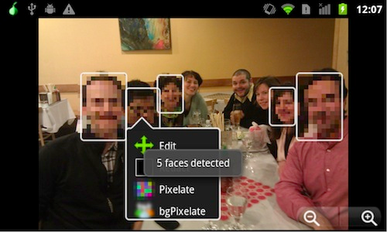
Obscuracam
A secure camera application being developed with WITNESS, to help improve visual privacy, secure human rights media content, and innovate in software camera tools for activists.

Slide 35

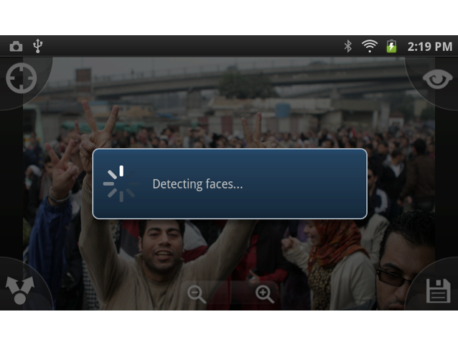
Automatic Face Detection

Slide 36
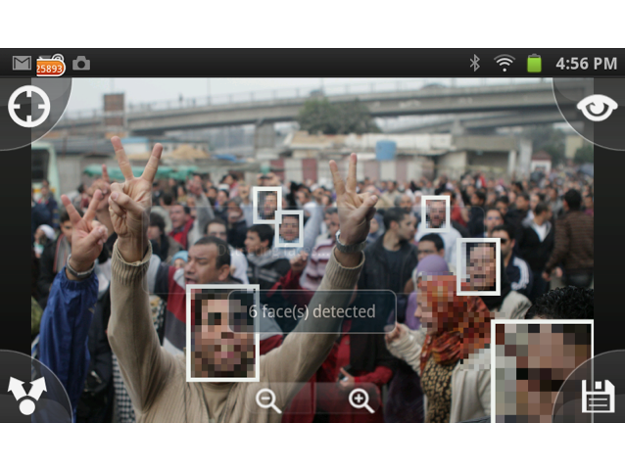
Faces Detected

Slide 37
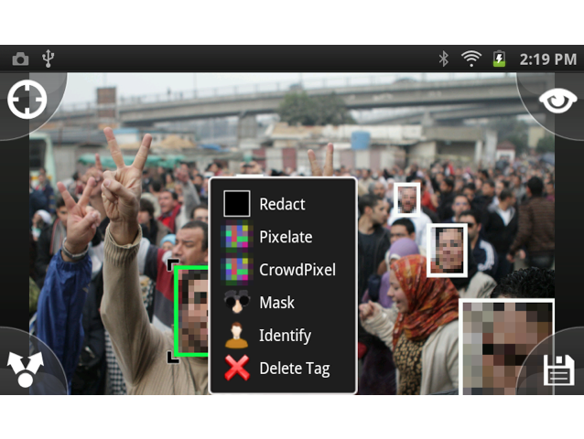
Edit Menu

Slide 38
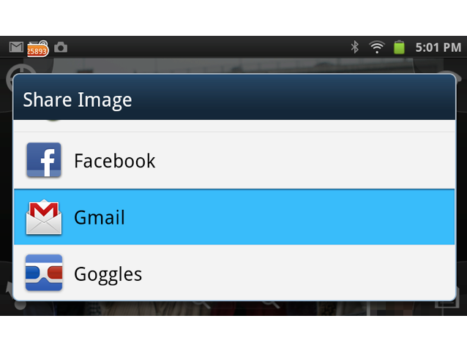
Email or Share

Slide 39
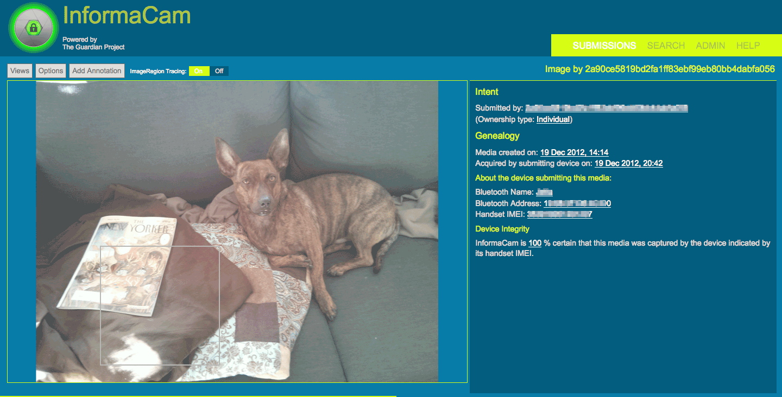
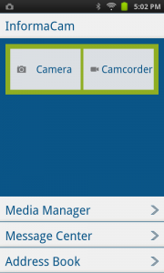
informacam
A secure camera application being developed with WITNESS, to help improve visual privacy, secure human rights media content, and innovate in software camera tools for activists.
Notes:
In situations like Syria, where the government may be monitoring all incoming and outgoing internet traffic, the app uses TOR to hide the traffic in the first place, and encrypts all data on the device and during transmission. Furthermore, a colleague of Harlo’s used ObscuraCam (a sibling project of InformaCam) to film a protest in Tunisia, and easily protected the identities of everyone filmed.
These sensors include:
Motion, such as accelerometers which record any movement occurring during the recording process – this will help to determine if the person was in a vehicle while recording for example.
Position, such as GPS which will provide fairly exact coordinates where the image or video was taken – this data can later be plotted on a map
Environmental, such as thermometers which can be later referenced against recorded temperature or other climatic data

Slide 40
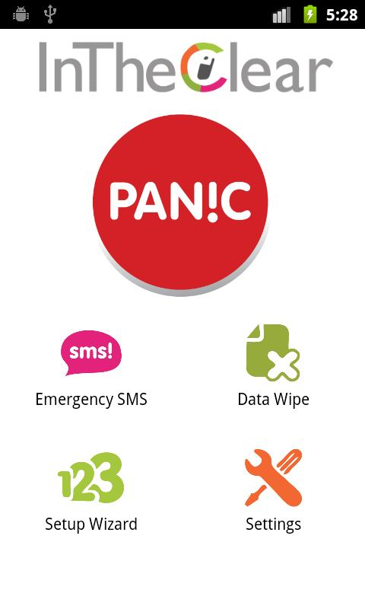
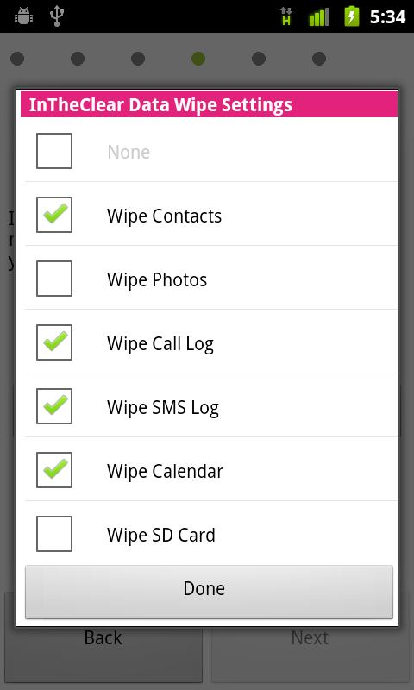
In The Clear
A “poison pill” app data wipe and emergency SMS distress beacon.
Quick, one-touch activate
Wipe data across different Android apps and external storage / SD Card
Emergency SMS sends in background repeatedly with location and cell network dataAlso available on Blackberry and Java (Nokia, etc) phones

Slide 41


Developer Tools
Software routines and utilities to help programmers understand and code application with security and privacy by default

Slide 42
Cipher Suite
A Growing Number Of Tools For Securing Apps & Communication on Android

Slide 43

IOCipher
Transparent encrypted virtual disks for Android. This allows Android app developers to use the familiar and well documented android.database.* API to build in encrypted storage into their apps
libsqlfs+SQLCipher built on top of SQLite, which gives a single, very portable file that is the whole filesystem
libsqlfs is a FUSE module
Successful alpha of IOCipherServer/SpotSync app

Slide 44
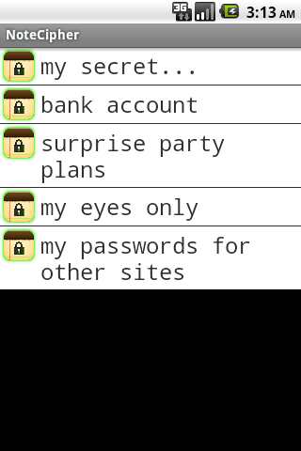
SQLCipher
SQLCipher is an SQLite extension that provides encryption of per-app database files.
Symmetric, 256-bit AES
Existing open-source project, ported to Android
Simple process to enable encryption on existing apps
Cross-device and desktop portable data compatibility
Robust, tested and performs well on mobile devices

Slide 45

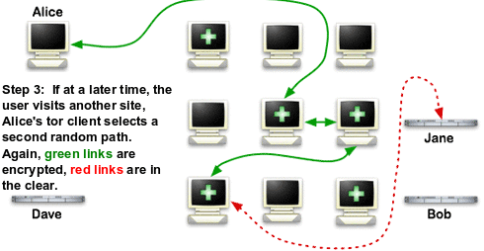
NetCipher
Enabling secure and anonymous network proxying. This is an Android Library for use by any application that wishes to route its network traffic through Orbot/Tor.
StrongTrustManager: a robust implementation of an TLS/SSL certificate verifier, that can be customized with any set of certificate authorities
Proxied Connection Support: HTTP and SOCKS proxy connection support for HTTP and HTTP/S traffic through specific configuration of the Apache HTTPClient library
OrbotHelper: a utility class to support application integration with Orbot: Tor for Android. Check if its installed, running, etc.
Transparent proxying of application data traffic on rooted devices
Applications that provide traffic proxying to Orbot’s local HTTP and/or SOCKS proxies can access the Tor network on non-rooted devices
Successful integration with official Twitter app

Slide 46
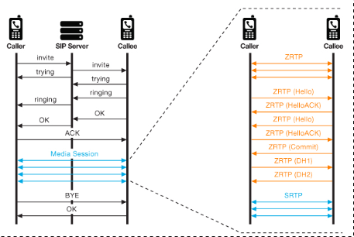

Open Secure Telephony Network
Secure voice communications schematics featuring an open client and server for a federated network. Standards development for VOIP end-to-end security, with verifiable encryption, minimal logging.
Built-in public key encryption standards with ZRTP
Coordinating a network of compliant server/service instances
Coordinating client software on mobile and desktop, including PrivateWave, Redphone, Groundwire, Keywe, and Debian

Slide 47

The Guardian Project is under active development, with beta stage deployments of software and hardware with partner organizations underway.
Our apps are available through our site, through partners sites and in the Android Market, and in total have been downloaded over a million times.
We are actively seeking developers, designers, users, partners and funders for our work.
Please visit https://guardianproject.info for more information.

Slide 48
The Guardian Project
www.guardianproject.info
info@guardianproject.info

